Slide 1

Introduction To Management
Course Code: GC152
Lecture # 09
By
ISLAM ZADA
Lecturer in Department of Computer Science & Software Engineering,
International Islamic University, Islamabad.

Slide 2
Hierarchy of need theory.
The qualities of a good leader

Slide 3
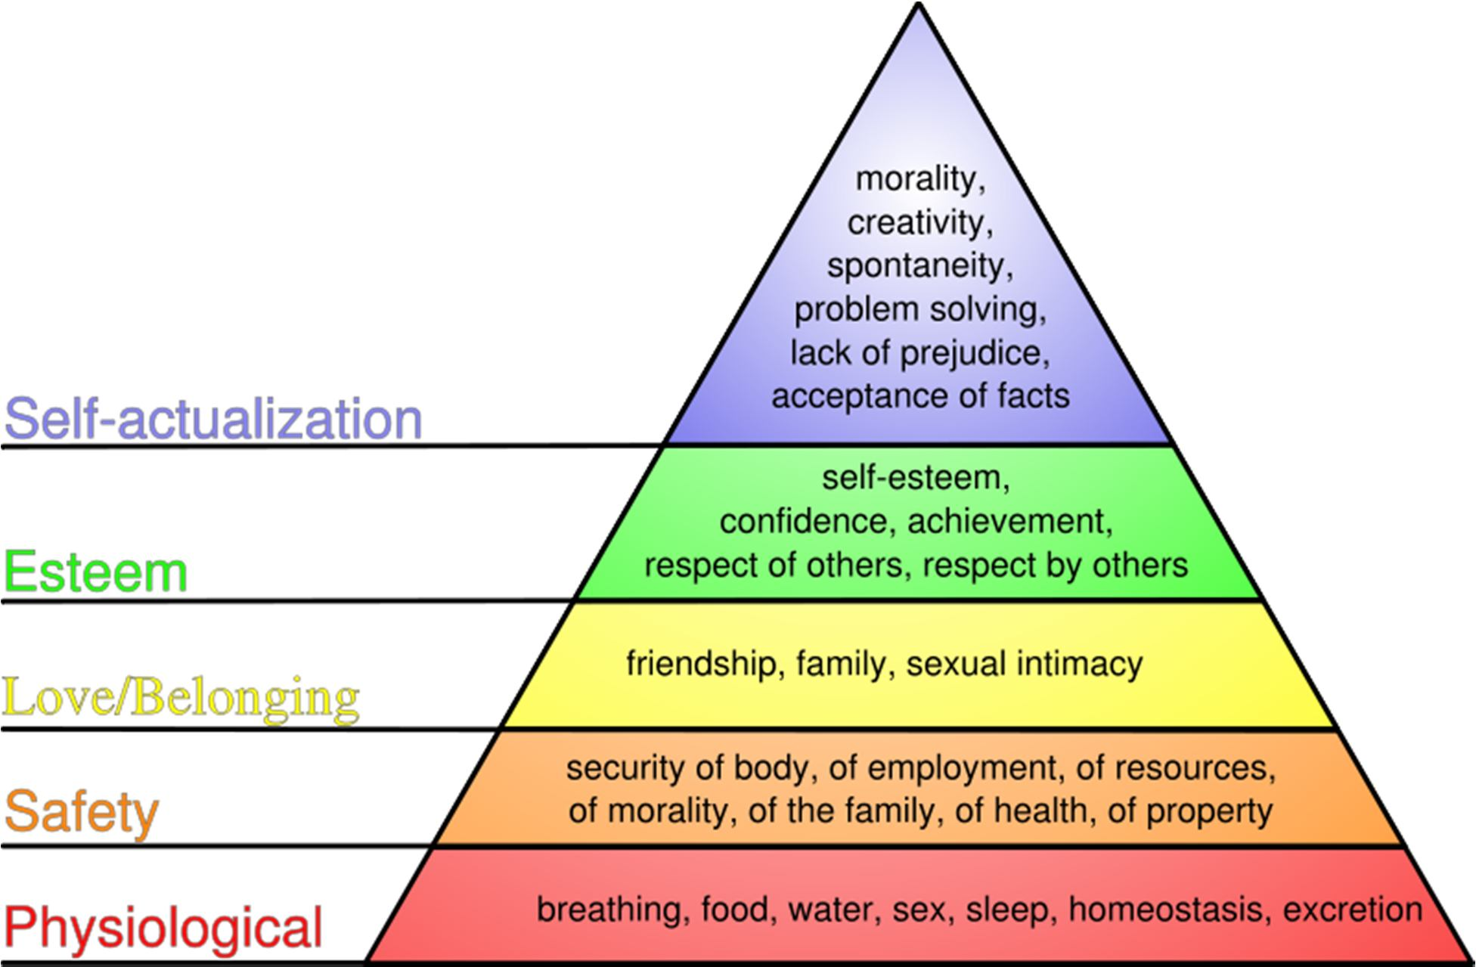
Hierarchy of need theory

Slide 4
Hierarchy of need theory
Physiological Needs:
Physiological needs are those required to sustain life, such as:
air
water
nourishment
Sleep
According to Maslow's theory, if such needs are not satisfied then one's motivation will arise from the quest to satisfy them.
Higher needs such as social needs and esteem are not felt until one has met the needs basic to one's bodily functioning.

Slide 5
Hierarchy of need theory
Safety:
• Once physiological needs are met, one's attention turns to safety and security in order to be free from the threat of physical and emotional harm.
Such needs might be fulfilled by::
Living in a safe area
Medical insurance
Job security
Financial reserve
According to Maslow's hierarchy, if a person feels that he or she is in harm's way, higher needs will not receive much attention..

Slide 6
Hierarchy of need theory
Social Needs:
Once a person has met the lower level physiological and safety needs, higher level needs become important, the first of which are social needs.
Social needs are those related to interaction with other people and may include:
Need for friends
Need for belonging
Need to give and receive love

Slide 7
Hierarchy of need theory
Esteem:
Once a person feels a sense of "belonging", the need to feel important arises.
Esteem needs may be classified as internal or external. Internal esteem needs are those related to self-esteem such as self-respect and achievement.
External esteem needs are those such as social status and recognition. Some esteem needs are:
Self-respect
Achievement
Attention
Recognition
Reputation
Maslow later refined his model to include a level between esteem needs and self- actualization: the need for knowledge and aesthetics..

Slide 8
Hierarchy of need theory
Self-Actualization:
It is the quest of reaching one's full potential as a person.
Unlike lower level needs, this need is never fully satisfied; as one grows psychologically there are always new opportunities to continue to grow.
Truth
Justice
Wisdom
Meaning
Self-actualized persons have frequent occurrences of peak experiences, which are energized moments of profound happiness and harmony.
According to Maslow, only a small percentage of the population reaches the level of self-actualization.

Slide 9
The Qualities of a Good Leader
1. Proactive vs. Reactive:
The exceptional leader is always thinking three steps ahead.
Working to his/her own environment with the goal of avoiding problems before they arise.
2. Flexible/Adaptable
How do you handle yourself in unexpected or uncomfortable situations? An effective leader will adapt to new surroundings and situations, doing his/her best to adjust.
A Good Communicator:
As a leader, one must listen...a lot! You must be willing to work to understand the needs and desires of others.
A good leader asks many questions, considers all options, and leads in the right direction.

Slide 10
The Qualities of a Good Leader
4. Respectful:
Treating others with respect will ultimately earn respect.
5. Quiet Confidence:
Be sure of yourself with humble intentions..
6. Enthusiastic:
Excitement is contagious. When a leader is motivated and excited about the cause people will be more inclined to follow.
7. Open-Minded:
Work to consider all options when making decisions.
A strong leader will evaluate the input from all interested parties and work for the betterment of the whole.

Slide 11
The Qualities of a Good Leader
8. Resourceful:
Utilize the resources available to you.
If you don't know the answer to something find out by asking questions. A leader must create access to information.
9. Rewarding:
An exceptional leader will recognize the efforts of others and reinforce those actions. We all enjoy being recognized for our actions!
10. Well Educated:
Knowledge is power. Work to be well educated on community policies, procedures, organizational norms, etc.
Further, your knowledge of issues and information will only increase your success in leading others.
11. Open to Change:
A leader will take into account all points of view and will be willing to change a policy, program, cultural tradition that is outdated, or no longer beneficial to the group as a whole..

Slide 12
The Qualities of a Good Leader
12. Interested in Feedback:
How do people feel about your leadership skill set? How can you improve? These are important questions that a leader needs to constantly ask the chapter.
View feedback as a gift to improve.
13. Evaluative:
Evaluation of events and programs is essential for an organization/group to improve and progress.
An exceptional leader will constantly evaluate and change programs and policies that are not working.
14. Organized:
Are you prepared for meetings, presentations, and events and confident that people around you are prepared and organized as well?.

Slide 13
The Qualities of a Good Leader
15. Consistent:
Confidence and respect cannot be attained without your leadership being consistent. People must have confidence that their opinions and thoughts will be heard and taken into consideration.
16. Delegator:
An exceptional leader realizes that he/she cannot accomplish everything on his own.
A leader will know the talents and interests of people around him/her, thus delegating tasks accordingly.
17. Initiative:
A leader should work to be the motivator, an initiator.
He/she must be a key element in the planning and implementing of new ideas, programs, policies, events, etc..

Slide 14
Introduction to Management, 13th Edition International Student Version, John R. Schermerhorn Jr., Daniel G. Bachrach, ISBN: 978-1-118-95118-7
Introduction to Management-4th Edition. Author(s):Richard Pettinger, publisher: Red Globe Press.

